Slide 1
Mitigating Algorithmic Bias in Machine Learning Models for Skin Cancer Detection

Slide 2
Introduction and Literature Review

Slide 3
Research Significance
High Prevalence of Skin Cancer
Global Dermatologist Shortage
Rise of Telemedicine
Li et al., 2022

Slide 4
Research Significance
Skin cancer is very common, but highly treatable if detected early.
Machine learning (ML) algorithms can help; the Convolutional Neural Network (CNN) is the most popular.
Cassidy et al., 2022; American Academy of Dermatology Association, n.d.; Li et al., 2022

Slide 5
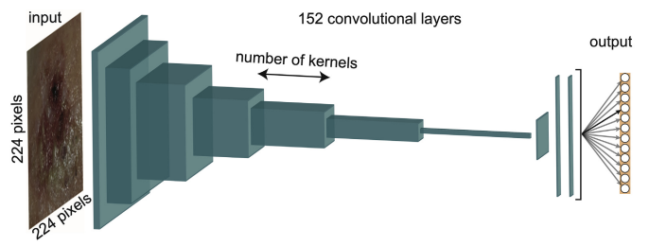
CNN Model Structure
CNNs analyze dermoscopic images and output a classification: malignant or benign.
Cullell-Dalmau et al., 2020

Slide 6
Input: Dermoscopic Images
International Skin Imaging Collaboration (ISIC): 75.2% of all dermoscopic images from 2013-2020
Dermatology textbooks and atlases
Newer data: Diverse Dermatology Images (DiDI)
Gutman et al., 2016; Codella et al., 2017; Wen et al., 2022; Daneshjou et al., 2022

Slide 7
Limitations of Existing Datasets
Under-representation: darker skin tones are “merely 4% to 18% of the total number of images”
Inconsistent metadata reporting for age, gender, and skin tone.
Rezk et al., 2022; Wen et al., 2022

Slide 8
Output: Algorithmic Bias
“Lack of racial or diverse ethnic inclusion during the training process of a machine learning algorithm”
Biased, inaccurate outputs
Abubakar et al., 2020

Slide 9
Solution 1: Skin Tone Labeling
FST Value | Description | Skin Tone
Type I | White skin. Always burns, never tans.
Type II | Fair skin. Always burns, tans with difficulty.
Type III | Average skin color. Sometimes mild burn, tan about average.
Type IV | Light-brown skin. Rarely burns. Tans easily.
Type V | Brown skin. Never burns. Tans very easily
Type VI | Black skin. Heavily pigmented. Never burns, tans very easily
Fitzpatrick Skin Type (FST) scale is used to retroactively add skin tone data for older datasets
Groh et al., 2022; Ward et al., 2017

Slide 10
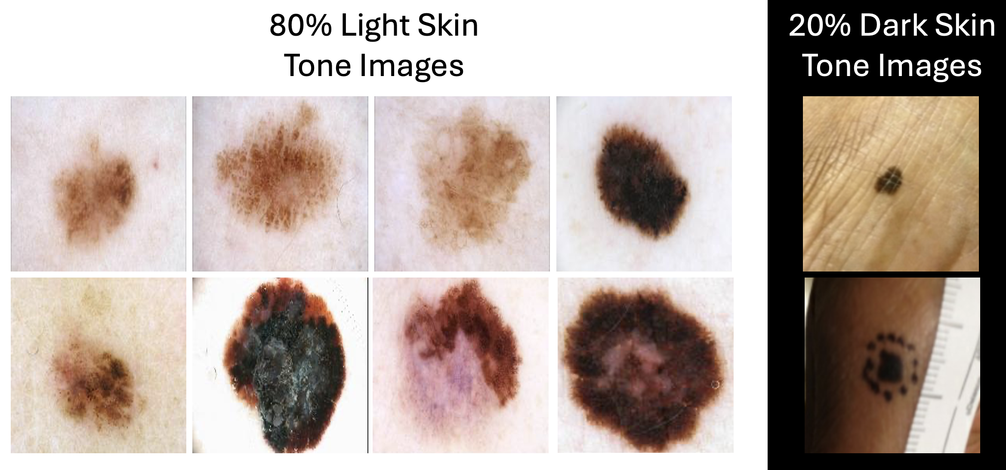
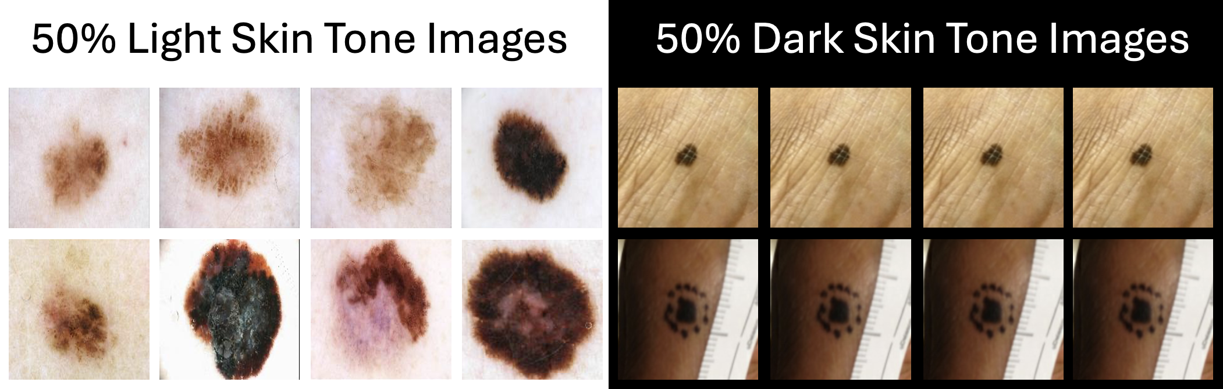
Solution 2: DB-VAE Resampling
Adaptive resampling using a debiasing variational autoencoder (DB-VAE)
Initial Dataset
Resampled Dataset
Amini et al., 2019

Slide 11
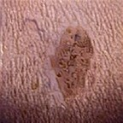
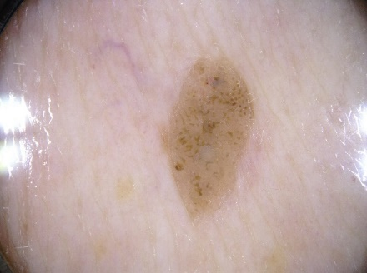
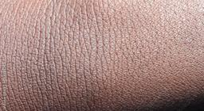
Solution 3: Artificial Image Generation
Neural style transfer to generate lesions on darker skin tones.
Stylized Image
Content Image
Style Image
ISIC_0014649.jpg
Rezk et al., 2022; Codella et al., 2017; AlexKaiLe, n.d.

Slide 12
Gaps to Fill
Utilize & evaluate DiDI Dataset
Standard comparison for debiasing approaches
Create combination approaches

Slide 13
Research Question
What is the best way to mitigate algorithmic bias in machine learning malignance classifiers used for dermatology?

Slide 14
Initial Expectations
Supplementation with DiDI Dataset will mitigate bias
Standard comparison: all modifications will mitigate bias
Combination model: will outperform individual debiasing modifications

Slide 15
Method and Results

Slide 16
Methodology
Curate Training
Datasets
Build Models
Process Images (N = 3288)
Train Models
Quantify Underrepresentation
Evaluate Models

Slide 17
Methodology
Curate Training
Datasets
Build Models
Process Images (N = 3288)
Train Models
Quantify Underrepresentation
Evaluate Models

Slide 18
Curate Input Data
ISIC: 1976 images
DDI: 656 images
ArGI: 656 images
Gutman et al., 2016; Codella et al., 2017; Daneshjou et al., 2022; AlexKaiLe, n.d.

Slide 19
Methodology
Curate Training
Datasets
Build Models
Process Images (N = 3288)
Train Models
Quantify Underrepresentation
Evaluate Models

Slide 20
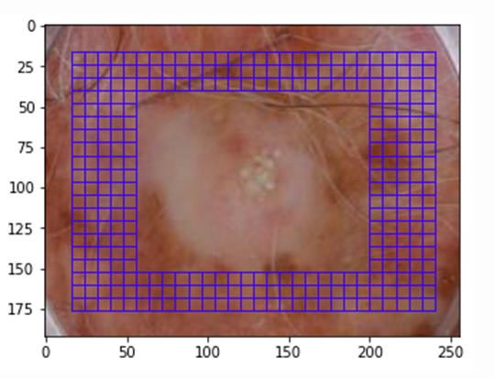
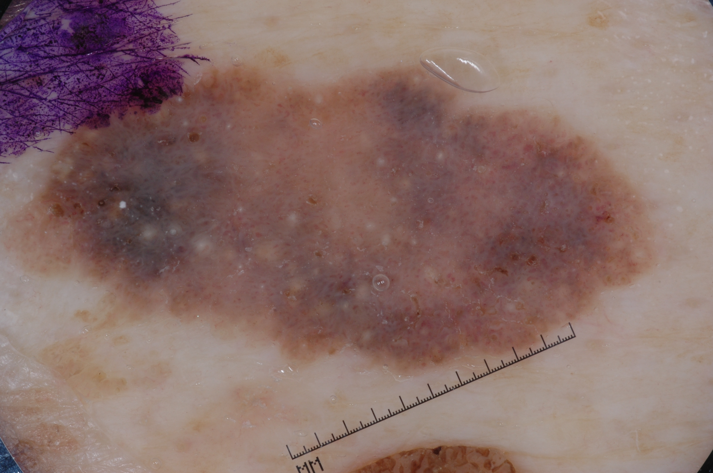
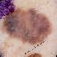
Process Training Datasets
Compute skin tone from pixels, excluding the lesion
Stretch images to fit square aspect ratio
Derm-ita, 2021; Codella et al., 2017

Slide 21
Methodology
Curate Training
Datasets
Build Models
Process Images (N = 3288)
Train Models
Quantify Underrepresentation
Evaluate Models

Slide 22
Quantify Underrepresentation
Keiser et al., 2012

Slide 23
Methodology
Curate Training
Datasets
Build Models
Process Images (N = 3288)
Train Models
Quantify Underrepresentation
Evaluate Models

Slide 24
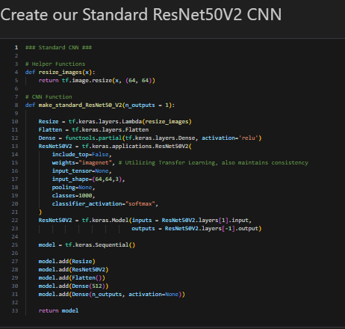
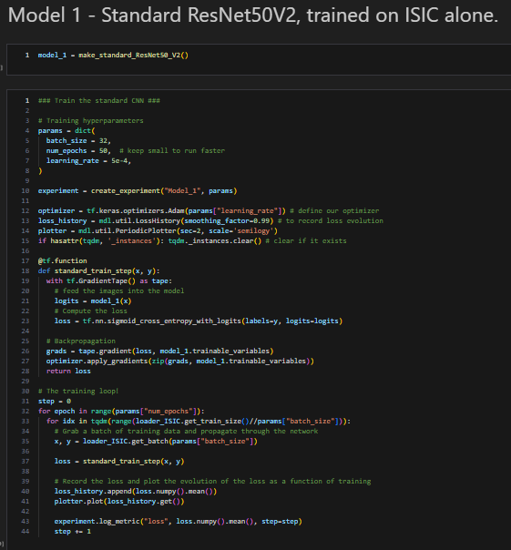
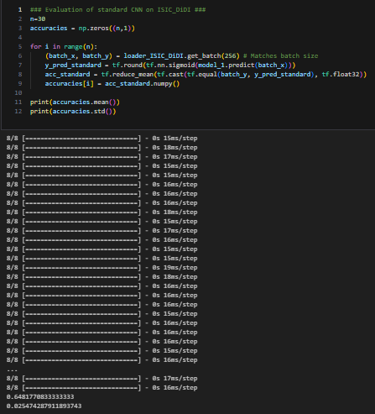
Example Model: Model 1
Accuracy
Mean & SD
Build Model
Define Layer Architecture
Train Model
Custom Training Loop
Evaluate Model
30 runs, batch size 32

Slide 25
Model Results and Discussion

Slide 26
Compare Models
Model #s | Modification
1, 4 | None
2, 5 | Dataset Supplementation
3, 6 | Artificial Image Generation
Standard ResNet50v2 CNN
DB-VAE

Slide 27
Dataset Supplementation
Model #s | Modification
1, 4 | None
2, 5 | Dataset Supplementation
3, 6 | Artificial Image Generation
Standard ResNet50v2 CNN
DB-VAE

Slide 28
DB-VAE Resampling
Model #s | Modification
1, 4 | None
2, 5 | Dataset Supplementation
3, 6 | Artificial Image Generation
Standard ResNet50v2 CNN
DB-VAE

Slide 29
DB-VAE Resampling
Model #s | Modification
1, 4 | None
2, 5 | Dataset Supplementation
3, 6 | Artificial Image Generation
Standard ResNet50v2 CNN
DB-VAE

Slide 30
Artificial Image Generation
Model #s | Modification
1, 4 | None
2, 5 | Dataset Supplementation
3, 6 | Artificial Image Generation
Standard ResNet50v2 CNN
DB-VAE

Slide 31
Combination Model
ArGI
DB-VAE
Combo
Standard ResNet50v2 CNN
DB-VAE

Slide 32
Conclusions, Implications and Limitations

Slide 33
Conclusions: Answering the RQ
Dataset Supplementation
DB-VAE Resampling
ArGI + DB-VAE Combo
Artificial Image Generation

Slide 34
Implications
To improve the standard of care for patients with darker skin tones:
Short term: DB-VAE Resampling and Artificial Image Generation
Long term: collect more dermoscopic images of darker skin tones using standardized practices
Ganapathi et al., 2022; Mittermaier et al., 2023

Slide 35
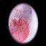
Limitation: FST Misclassification
FST Value | Description | Color
Type I | White skin. Always burns, never tans.
Type II | Fair skin. Always burns, tans with difficulty.
Type III | Average skin color. Sometimes mild burn, tan about average.
Type IV | Light-brown skin. Rarely burns. Tans easily.
Type V | Brown skin. Never burns. Tans very easily
Type VI | Black skin. Heavily pigmented. Never burns, tans very easily
ISIC_000004 after processing
Ward et al., 2017

Slide 36
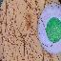
Limitation: FST Misclassification
FST Value | Description | Color
Type I | White skin. Always burns, never tans.
Type II | Fair skin. Always burns, tans with difficulty.
Type III | Average skin color. Sometimes mild burn, tan about average.
Type IV | Light-brown skin. Rarely burns. Tans easily.
Type V | Brown skin. Never burns. Tans very easily
Type VI | Black skin. Heavily pigmented. Never burns, tans very easily
ISIC_003056 after processing
Ward et al., 2017

Slide 37
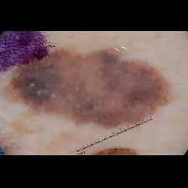
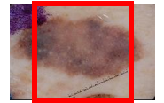
Limitation: Image Processing
ISIC_012773’s original image, overlayed with a 1:1 aspect ratio square
ISIC_012773, resized with padding
ISIC_012773 after processing

Slide 38
Future Directions
Test other ML algorithms [support vector machines (SVM), k-nearest neighbor classification (KNN)] on standardized comparison framework,
Create ArGI + DB-VAE combinations using other image generation algorithms [generative adversarial networks (GAN)]
Chan et al., 2020

Slide 39
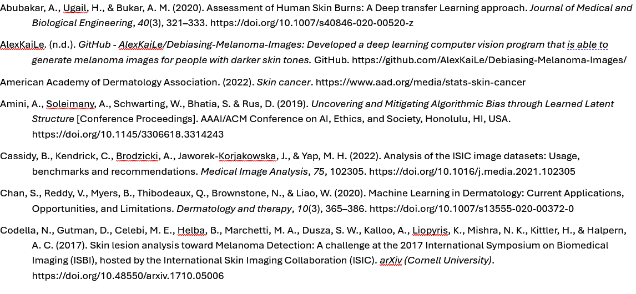
References

Slide 40
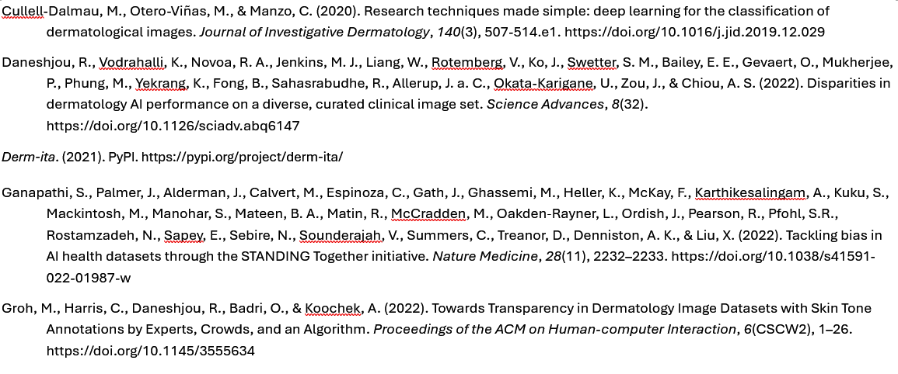
References

Slide 41
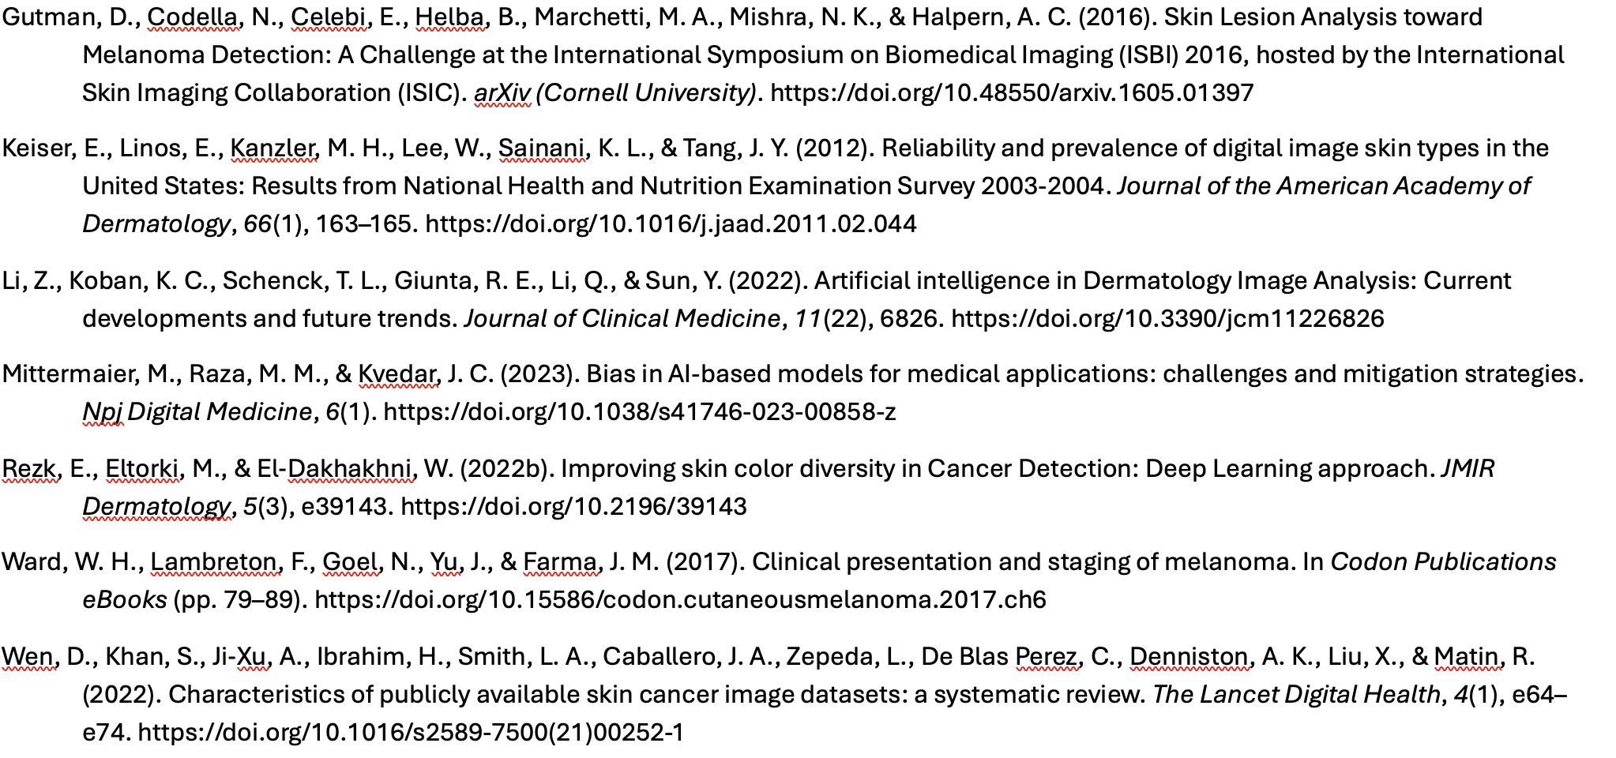
References

